Slide 1
SHADOWFOX | MACHINE LEARNING ENGINEER INTERNSHIP | ADVANCED LEVEL
ReviewMind AI
Universal Customer Feedback Intelligence Platform
Sentiment analysis • Emotion detection • Topic modelling • Streamlit analytics
github.com/samarthjain-ai/ShadowFox-ML-Internship
Notes:
Introduce ReviewMind AI, the advanced-level project of the ShadowFox Machine Learning Engineer Internship. It turns unstructured customer feedback into insight using classical ML, transformer NLP and an interactive Streamlit application.

Slide 2
Project Overview
An AI-powered platform that turns raw text reviews into actionable insight, runnable locally with no paid LLM API.
1
Upload & profile
2
Sentiment
3
Emotion
CSV / Excel, data-quality checks, column detection
TF-IDF + Logistic Regression or fine-tuned DistilBERT
Pretrained DistilRoBERTa classifier
4
Topics
5
Ask ReviewMind
6
Visualise & export
TF-IDF + NMF theme discovery
Local rule-based Q&A over your data
Charts, CSV and PDF report
Notes:
The platform has six capabilities: dataset upload and profiling, two sentiment models, emotion detection, topic modelling, a local rule-based assistant, and visualisation with exports. Nothing depends on a paid external API.

Slide 3
Problem Statement
The challenge
The approach
Businesses collect large volumes of unstructured feedback
Manual reading is slow and inconsistent
Recurring problems and customer preferences are hard to spot
Every new dataset tends to need a new analysis pipeline
One platform for any compatible feedback file
Automatic text and label column detection
Sentiment, emotion and topic analysis
Charts and plain-language answers, run locally
Notes:
Frame the problem: feedback volume outgrows manual review. ReviewMind AI offers one reusable pipeline that adapts to different datasets and runs locally.

Slide 4
Objectives
1
Build and evaluate sentiment classification on IMDb reviews
2
Compare TF-IDF + Logistic Regression with fine-tuned DistilBERT
3
Add emotion detection and topic discovery
4
Create a modular backend that profiles, cleans and orchestrates analysis
5
Deliver an interactive Streamlit application
6
Verify the backend with integration tests
Notes:
Six objectives: model development, a like-for-like comparison, extra NLP capabilities, a modular backend, the Streamlit app, and verification through integration tests.

Slide 5
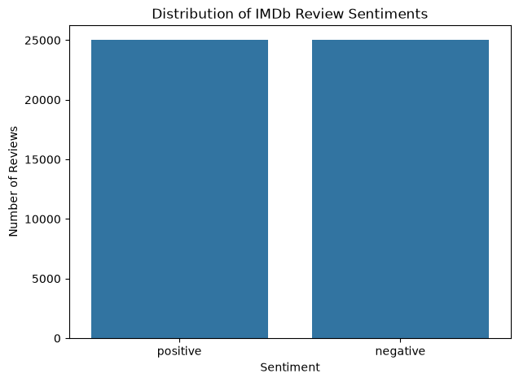
Dataset: IMDb Movie Reviews
50,000
418
raw reviews
duplicates removed
49,582
9,917
cleaned reviews
held-out test reviews
Columns: review, sentiment
Raw labels: 25,000 / 25,000
80/20 stratified split, seed 42
Class distribution of the raw dataset (notebook output)
Notes:
The dataset is the IMDb 50,000-review benchmark from Zenodo. 418 exact duplicates were removed leaving 49,582 reviews, split 80/20 into 39,665 training and 9,917 test reviews. Models trained here may transfer imperfectly to other domains.

Slide 6
Technology Stack
Language
App
Data
ML
Python 3.11
Streamlit
Pandas, NumPy
Scikit-learn
Deep learning
NLP
Visualisation
Storage & tools
PyTorch (CPU)
Hugging Face Transformers
Matplotlib, Seaborn
Joblib, Jupyter, VS Code, Git
Pretrained models: distilbert-base-uncased (fine-tuned) • j-hartmann/emotion-english-distilroberta-base
Notes:
The stack is Python with Streamlit for the UI, scikit-learn for the classical models, PyTorch and Transformers for DistilBERT and the emotion model. No GPU was used.

Slide 7
Methodology and Application Workflow
1
2
3
4
5
Upload
Profile
Select
Analyse
Explore
CSV / Excel or demo data
rows, missing, duplicates
feedback column + optional label
sentiment, emotion, topics, evaluation
charts, export, Ask ReviewMind
Rows with missing or blank feedback are excluded but accounted for
Evaluation runs only when a valid ground-truth label exists
Original uploaded data stays unchanged; results are stored separately
Notes:
Walk through the five stages of the app workflow. Highlight the robustness rules: blank rows are excluded, evaluation is skipped without labels, and the original data is never modified.

Slide 8
Model Development Pipeline
TF-IDF (30,000 features, 1-2 grams) + Logistic Regression
39,665 training reviews
IMDb dataset
50,000 reviews
Clean
-418 duplicates
49,582 reviews
Stratified split
80 / 20, seed 42
Balanced 4,000-review subset
DistilBERT fine-tune: 2 epochs, max length 192
Full test split
9,917 reviews
Cleaning: drop duplicates, replace <br /> markup, map labels to 0 / 1. TF-IDF fitted on training text only to avoid leakage.
Notes:
Both models share the same cleaned data and the same 9,917-review test split. Logistic Regression uses the full 39,665-review training set; DistilBERT uses a balanced 4,000-review subset because training ran on a CPU.

Slide 9
Model Development
TF-IDF + Logistic Regression
Fine-tuned DistilBERT
Emotion, Topics, Q&A
30,000 features
Unigrams + bigrams
min_df 2, max_df 0.95
max_iter 1000
Trained on 39,665 reviews
distilbert-base-uncased
4,000 balanced reviews
2 epochs, batch 16
lr 2e-5, AdamW, warm-up
Max length 192, CPU
~35.7 min total
Emotion: pretrained DistilRoBERTa (not retrained)
Topics: TF-IDF + NMF, 5 topics
Ask ReviewMind: local rule-based engine
Notes:
Three model families. The DistilBERT training loss fell from 0.4410 to 0.2297 across two epochs. The emotion model is used as published; topic discovery uses NMF with five components.

Slide 10
Evaluation and Results
90.52%
87.56%
LR accuracy
DistilBERT accuracy
0.9663
0.9501
LR ROC-AUC
DistilBERT ROC-AUC
Same 9,917-review test split
Precision tied: 0.8945 vs 0.8947
LR recall 0.9196 vs 0.8523
Notes:
Logistic Regression: accuracy 0.9052, precision 0.8945, recall 0.9196, F1 0.9069, ROC-AUC 0.9663. DistilBERT: 0.8756, 0.8947, 0.8523, 0.8730, 0.9501. LR wins on accuracy, recall, F1 and ROC-AUC; precision is effectively tied. Important caveat: the models were trained under different conditions (full training set versus a 4,000-review subset), so this is not a universal ranking of the architectures.

Slide 11
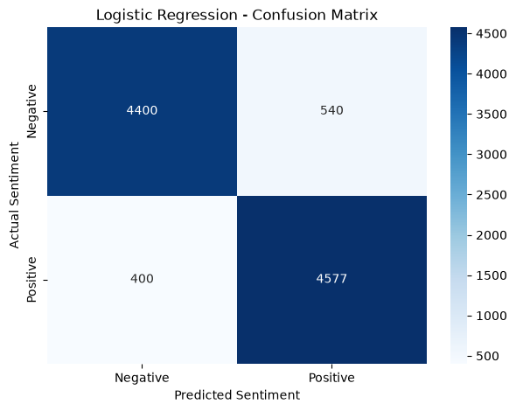
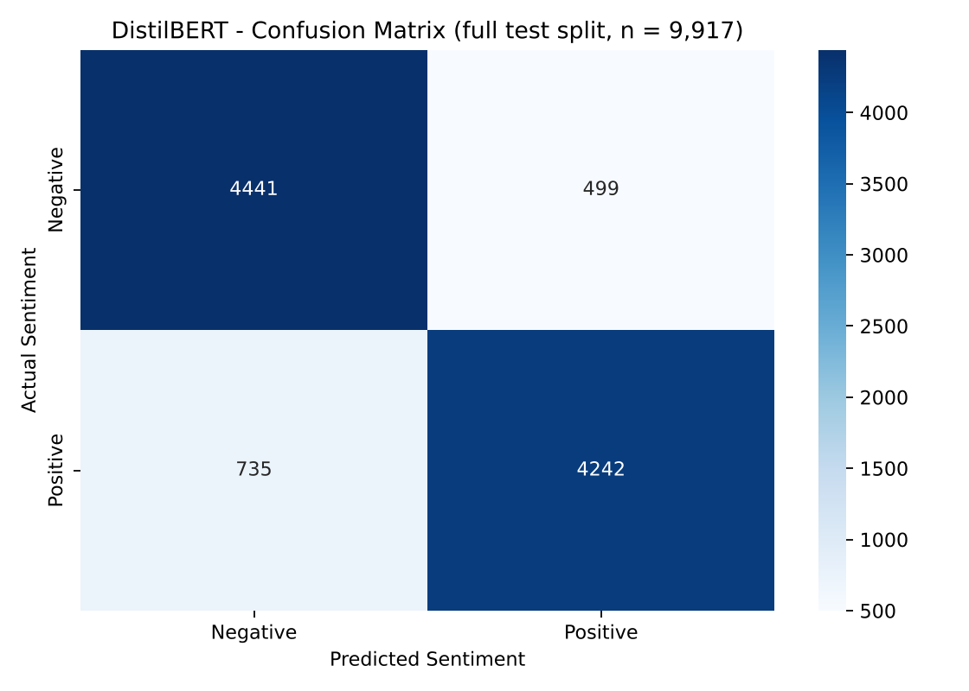
Important Visualizations: Errors
Logistic Regression: 940 errors (540 FP, 400 FN)
DistilBERT: 1,234 errors (499 FP, 735 FN)
Both on the 9,917-review test split. DistilBERT matrix re-plotted from recorded counts.
Notes:
The error patterns differ. Logistic Regression flags more false positives (540) than misses; DistilBERT misses many more positives (735 false negatives), which explains its lower recall.

Slide 12
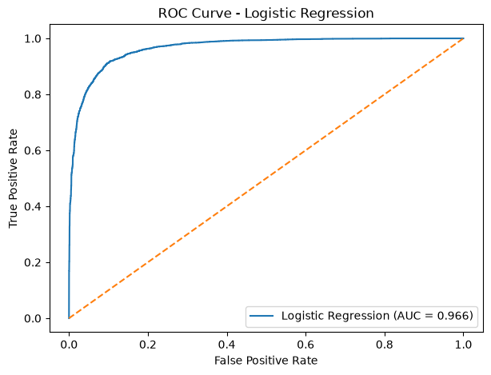
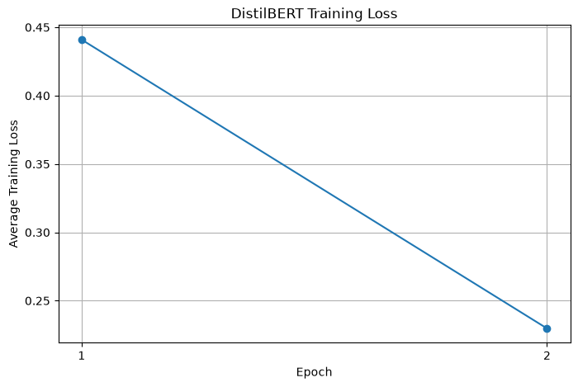
Important Visualizations: ROC and Training
ROC-AUC 0.966: strong ranking of positive over negative reviews
Loss 0.4410 to 0.2297 over two epochs
Notebook outputs. Training loss alone does not prove generalisation; held-out metrics do.
Notes:
The ROC curve hugs the top-left corner. The training loss halves across two epochs, but only held-out metrics establish generalisation.

Slide 13
Backend Integration Testing
10 / 10
CSV and Excel loading
Sentiment, emotion, topics and evaluation in one run
Custom, automatic and default analysis modes
Unlabeled data: evaluation skipped with a message
Missing and blank text: 30 rows in, 27 analysed
Invalid column, empty data, unknown analysis: clear errors
Product-feedback dataset: column detected automatically
recorded checks passed
Smoke tests, not a quality benchmark
Notes:
The backend notebook exercises the public functions without retraining. Note the 96% accuracy on the first 100 IMDb reviews is not a performance estimate, because those rows may overlap with the model's training data.

Slide 14
Challenges and Solutions
No GPU
Noisy text
Balanced 4,000-review subset, 192-token inputs
Removed 418 duplicates and <br /> markup
Fair comparison
Emotion model download
Identical 9,917-review test split; conditions stated
Longer timeouts, single worker, local copy
Messy uploads
App state loss
Blank rows excluded; evaluation skipped without labels
Persisted widgets, cached dataset
Notes:
Each challenge is drawn from the project materials. The biggest practical constraint was CPU-only training, which shaped the DistilBERT experiment.

Slide 15
Conclusion
Complete workflow: data, models, evaluation, app, tests
TF-IDF + Logistic Regression led on the IMDb test split: 90.52% accuracy, 0.9663 ROC-AUC
DistilBERT (4,000 reviews, 2 epochs, CPU): 87.56%, 0.9501; not a general ranking
Emotion, topics, charts, exports and a local assistant extend the platform beyond polarity
Models are analytical estimates, not verified facts about individual customers.
Notes:
Summarise: a complete ML workflow with honest, like-for-like evaluation. Stress the limitations: single-domain training data, reduced DistilBERT training, and rule-based assistant scope.

Slide 16
Future Scope
Domain adaptation
Stronger DistilBERT
Richer labels
Validate on real customer feedback from several industries
Full training split, validation set, more epochs, GPU
Neutral / fine-grained sentiment and multilingual support
Better topics
Smarter assistant
Deployment
Clean markup first, tune topic count, add coherence
Broader conversational coverage and reporting
Model optimisation and a hosted demo
Notes:
Future work follows directly from the documented limitations. The first priority is validating on real customer feedback, then retraining DistilBERT under fair conditions.

